Slide 1
TCE Annual General Meeting 2020-2021 Treasurer’s Report
Annual General Meeting: 2020-2021

Slide 2
Overview
Auditors
Financial results
Audit Opinion
Statement of Operations
Statement of Financial Position
Motion to approve financials
Annual General Meeting: 2020-2021

Slide 3

Auditors
Second year audit engagement
Selection made after the RFP process
5 year term
Annual General Meeting: 2020-2021

Slide 4
Audit Opinion
Clean and successful audit
No misstatements were identified
No significant deficiencies in internal controls were noted
Financial Statements present fairly in all material respects the financial position of TCE as of March 31, 2021
Annual General Meeting: 2020-2021

Slide 5
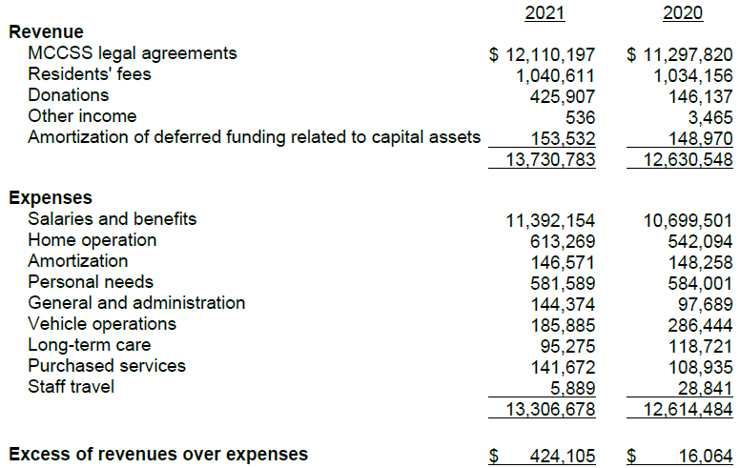
Statement of Operations For the year ended March 31, 2021
Annual General Meeting: 2020-2021

Slide 6
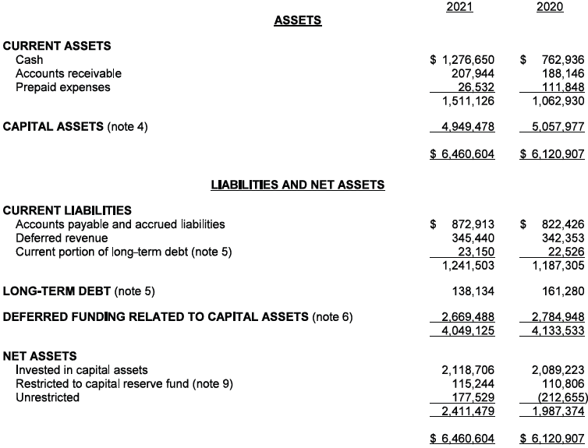
Statement of Financial Position March 31, 2021
Annual General Meeting: 2020-2021

Slide 7
Thank you! Questions?
Annual General Meeting: 2020-2021

Slide 8
Motion: Audited Financial Statements for the year ended March 31, 2021 be approved as presented
Annual General Meeting: 2020-2021

